Slide 1
Lecture 4

Slide 2
Inception in Detail

Slide 3
INCEPTION
Envision the product scope, vision, and Business case
1 or few weeks long activity
Get stakeholders consensuses/agreement on the vision of the project
Estimate project worth
Decide to proceed

Slide 4
Objectives
Establish initial common vision about the objectives of the project and acceptance criteria
Planning and preparing a business case
Define Project and software scope and boundary conditions
Identify main use cases of the system and develop initial use case model
Development of a candidate architecture
Estimating the overall cost and schedule for the entire project
Estimating potential risks
Development of a disposable prototype
Preparing the supporting environment for the project.
Planning for Elaboration phase

Slide 5
What Feasibility and Risk Analysis is?

Slide 6
Risk Management
There are two activities to be carried out as per part of Risk Analysis
Risk Assessment
Risk Control
In an iterative lifecycle, you select what increment to develop in an iteration based on a list of key risks. Since the iteration produces a tested executable, you can verify whether you have mitigated the targeted risks or not.
Waterfall Risk
RISK
Risk Reduction
Iterative Risk
TIME

Slide 7
Feasibility Analysis
“A measure of how beneficial or practical the development of a software system will be to an organization.”
Types
Technical
Operational
Economic
Schedule

Slide 8
Technical
can system be developed?
Is the technology or solution practical?
Do we currently possess the necessary technology?
Do we possess the necessary technical expertise?
Operational
can organization absorb the change?
Is the problem worth solving?
Will the solution to the problem work?
How do the end-users and managers feel about the problem (or solution)?
Economic
what is business justification?
Cost estimates
Benefit estimates
Schedule
can system be implemented in time available?
Can the project deadlines be met?
What will it cost to accelerate development?

Slide 9
Evaluation Criteria
Stakeholder agreement on scope definition
Agreement that the right set of requirements have been captured and that there is a shared understanding of these requirements.
Agreement that the cost/schedule estimates, priorities, risks, and development process are appropriate.
All risks have been identified and a mitigation strategy exists for each.
The project may be aborted or considerably re-thought if it fails to reach this milestone

Slide 10
INCEPTION ARTIFACTS
Artifact | Comment
Vision | Stakeholder prospective High level goals/ Constraints Business Case
Use case Model | Functional requirements/ Non Functional requirements Use cases
Supplementary Specifications | Other requirements
Glossary | Terms/ Definitions
Risk List & Risk Management Plan | Risks Mitigation plan
Prototypes | Validation of vision
Iteration Plan | Plan for Elaboration

Slide 11
You Didn’t Understand Inception when….
It is more than “a few” weeks long for most projects
There is an attempt to define most of the requirements
Estimates or plans are expected to be reliable
You define the architecture; rather, this should be done iteratively in elaboration
You believe that the proper sequence of work should be: 1) Define the requirements; 2) Design the architecture;
3) implement
There is no Business Case or Vision artifact
The names of most of the use cases and actors were not identified
All the use cases were written in detail
None of the use cases were written in detail; rather, 10-20% should be written in detail to obtain some realistic insight into the scope of the problem.

Slide 12
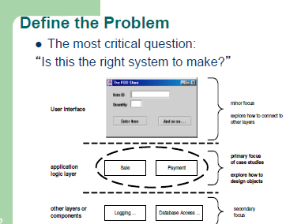

Slide 13
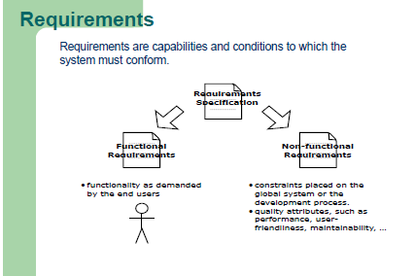

Slide 14
FURPS Requirement Model
In the UP, requirements are categorized according to the FURPS+ model
Functional - features, capabilities, security.
Usability - human factors, help, documentation.
Reliability - frequency of failure, recoverability, predictability.
Performance - response times, throughput, accuracy, availability,
resource usage.
Supportability - adaptability, maintainability, internationalization,
configurability.
The “+” means
Implementation - resource limitations, languages and tools, hardware..
Interface - constraints imposed by interfacing with external systems.
Operations - system management in its operational setting.
Packaging - for example, a physical box.
Legal - licensing and so forth.

